Slide 1
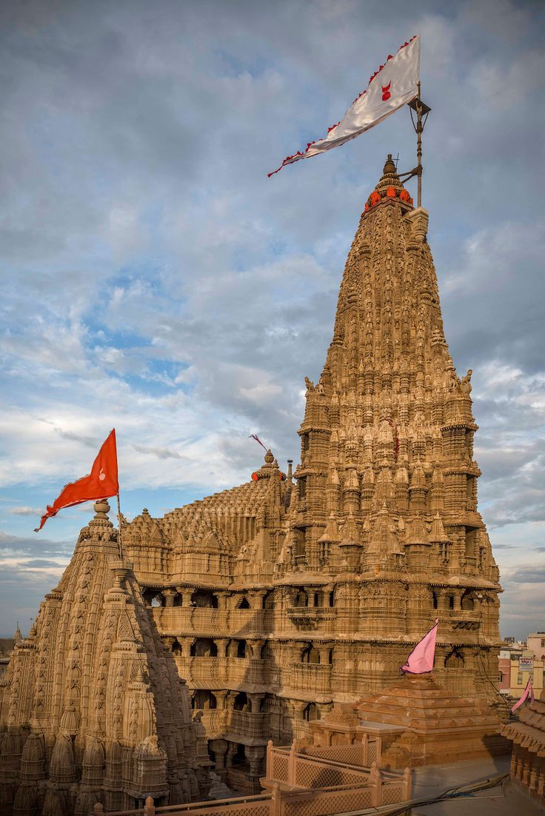
introduction to Dev bhumi Dwarka

Slide 2
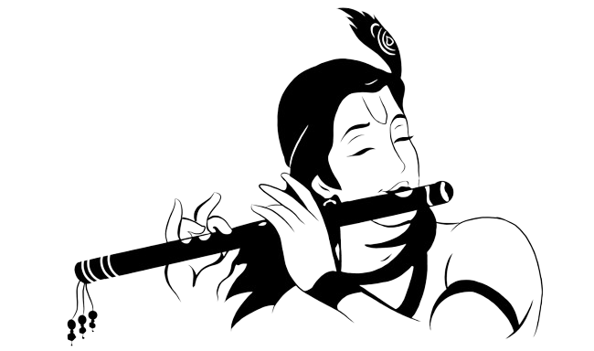
Index
Introduction
Abstract
Why is Dwarka called Devbhumi?
Why is Dwarka special?
What to see and do in Dwarka?
What does Krishna say in Bhagavad Gita?
Conclusion

Slide 3
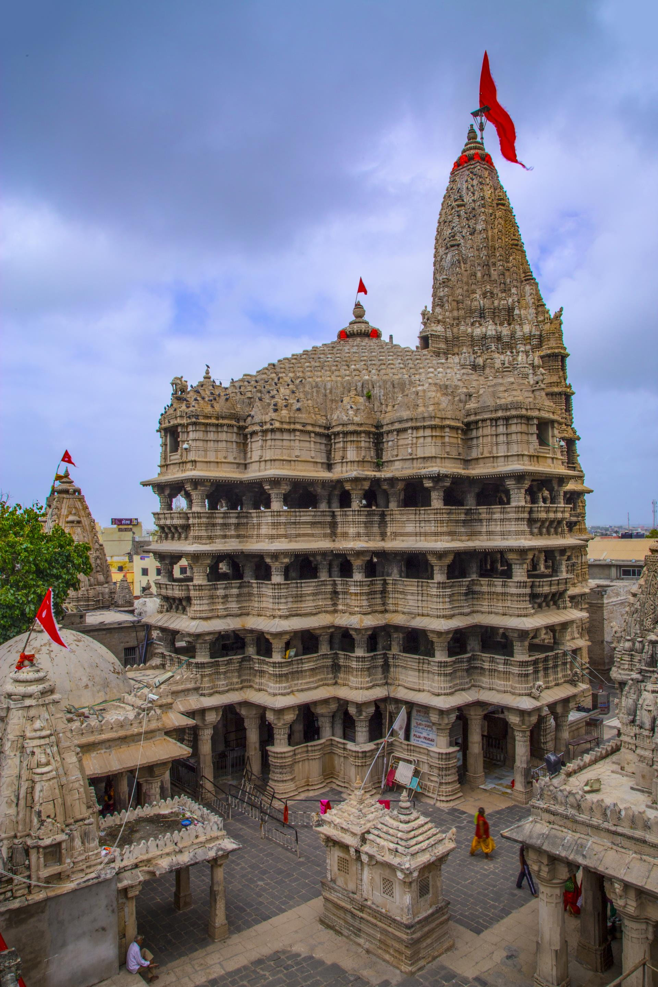
Introduction
Devbhumi Dwarka is a district in the state of Gujarat, India. It's located on the southern coast of the Gulf of Kutch, and its headquarters are in the city of Jamkhambhaliya. The district was created in 2013 from the Jamnagar district.

Slide 4
Devbhumi Dwarka's name comes from the Dwarkadhish Temple in Dwarka city. The temple is one of four holy places in Hindu mythology, and Dwarka is believed to have been the first capital of Gujarat
Dwarka is a holy city and a popular pilgrimage destination for Hindus. It's associated with Lord Krishna and has beautiful beaches.

Slide 5
Abstract
Dwarka is an ancient city on the western coast of Gujarat, India.
It's a significant religious center for Hindus and a pilgrimage destination for Hindus from around the world.
According to legend, Krishna settled in Dwarka after defeating his uncle Kansa. The city is also mentioned in the Mahabharata, an ancient prehistoric epic.

Slide 6
Why is Dwarka called Devbhumi?
The name Devbhumi Dwarka comes from the Dwarkadhish Temple, which is one of the four holy places in Hindu mythology. The city's name literally means the "gateway to heaven" in Sanskrit, as “Dwar” means "gate" and “ka” references "Brahma". Dwarka has also been referred to throughout its history as "Mokshapuri", "Dwarkamati", and "Dwarkavati".

Slide 7
Why is Dwarka special?
Dwarka is a holy city for Hindus.
Hindus believe that Lord Krishna lived in Dwarka for 12 years.
The city is also home to many temples, including the famous Dwarkadhish Temple.

Slide 8
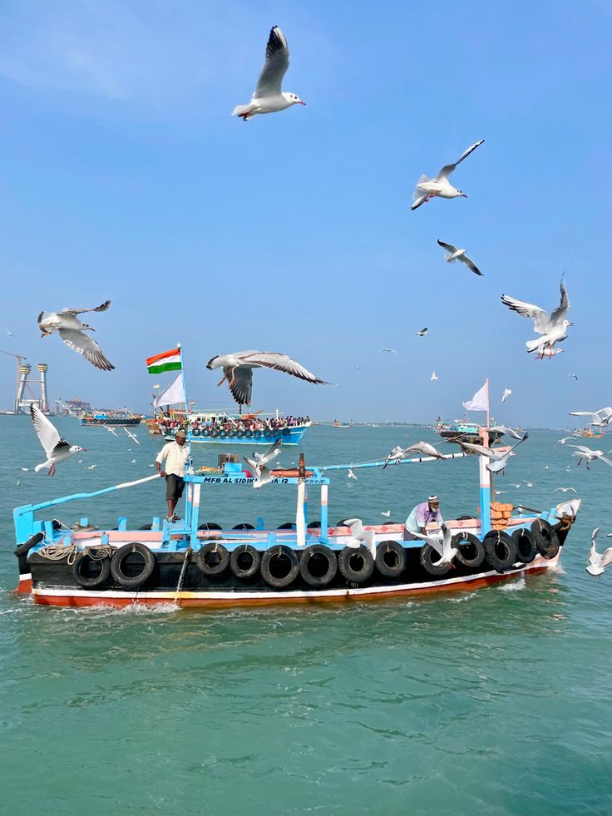
What to see and do in Dwarka:
Visit the Dwarkadhish Temple, the main temple in Dwarka.
Relax on the beach and enjoy the beautiful scenery.
Take a boat ride to the island of Bet Dwarka, where there is another temple dedicated to Lord Krishna.
Explore the markets of Dwarka and buy souvenirs.

Slide 9
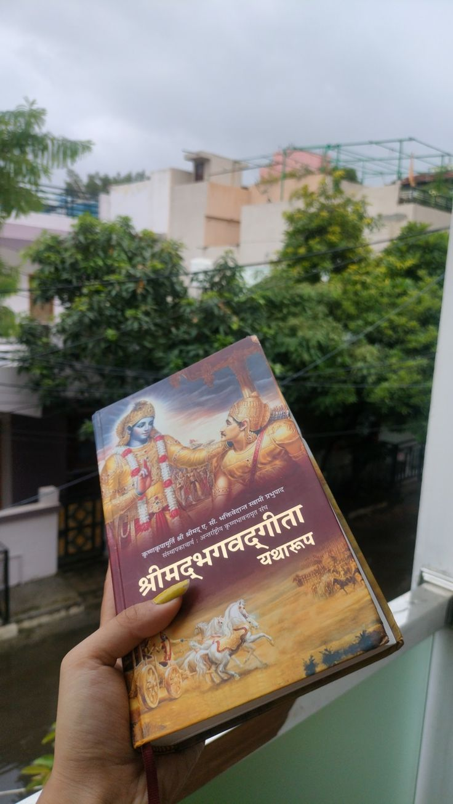
What does Krishna say in Bhagavad Gita?
The soul can never be cut to pieces by any weapon, nor burned by fire, nor moistened by water, nor withered by the wind. - Lord Krishna, Bhagavad Gita. Do everything you have to do, but not with greed, not with ego, not with lust, not with envy but with love, compassion, humility and devotion

Slide 10
Conclusion:
Dwarka is a beautiful and holy city that is worth visiting.
If you are looking for a place to relax and learn about Hindu culture, Dwarka is the perfect place for you.

Slide 11
Thank you for your time & attention. I appreciate the opportunity to speak with you today.

